Slide 1



SPOTIFY CLONE
Prepared By:
1) Name: Ayush Shah
Enrno.:21002170110167
Roll No.: 134
2)name :Vency Patel
Enrno:21002170110120
Roll No:111
3) Name: Rutvi Shah
Enrno:21002170110180
Roll No:132
4) Name: Aditya Dalwadi
Enrno:21002170110018
Roll No:131
Presented by :
Batch:A4

Slide 2
Project Outline
Idea:
Inspired by spotify original website.
A webpage showcase the front page of spotify.
Functionality:
The goal of the project is to build a website that mimic the appearances and also some of the basic functionalities of a popular music-streaming platform-spotify.
Spotify clone is a music streaming platform that helps you gain advantage of music.

Slide 3
DIFFERENT PAGES CREATED:
HOME PAGE- An image is inserted and an link for going to the main page is created.
LIBRARY PAGE-An image is inserted and a sentence no library is created is displayed with a link to go to the main web page.
LIKED SONGS-An image is displayed with the sentence “no liked songs” and a link to sign up and go to main web page.
PLAYLIST-An image is displayed with the sentence “no playlist is created ” and a link to sign up and go to main web page.
PREMIUM-An image is displayed and different statements with a link to go to the main web page.

Slide 4
DIFFERENT PAGES CREATED:
PRIVACY POLICY- An image is displayed with different statements and a link to go to the main web page.
CONTACT SUPPORT-An image is displayed with different statements and a link to go to the main web page.
SIGN UP FORM- A form is created with name , email and phone number to be entered by the user and submit and reset buttons are also created.
CREATE ACCOUNT-A page with different statements, logo a link to go to login.

Slide 5
Future Scope
With proper knowledge of GUI-graphic user interface and other functionalities not only a Spotify clone but an advanced and a better entire media player can be made.

Slide 6

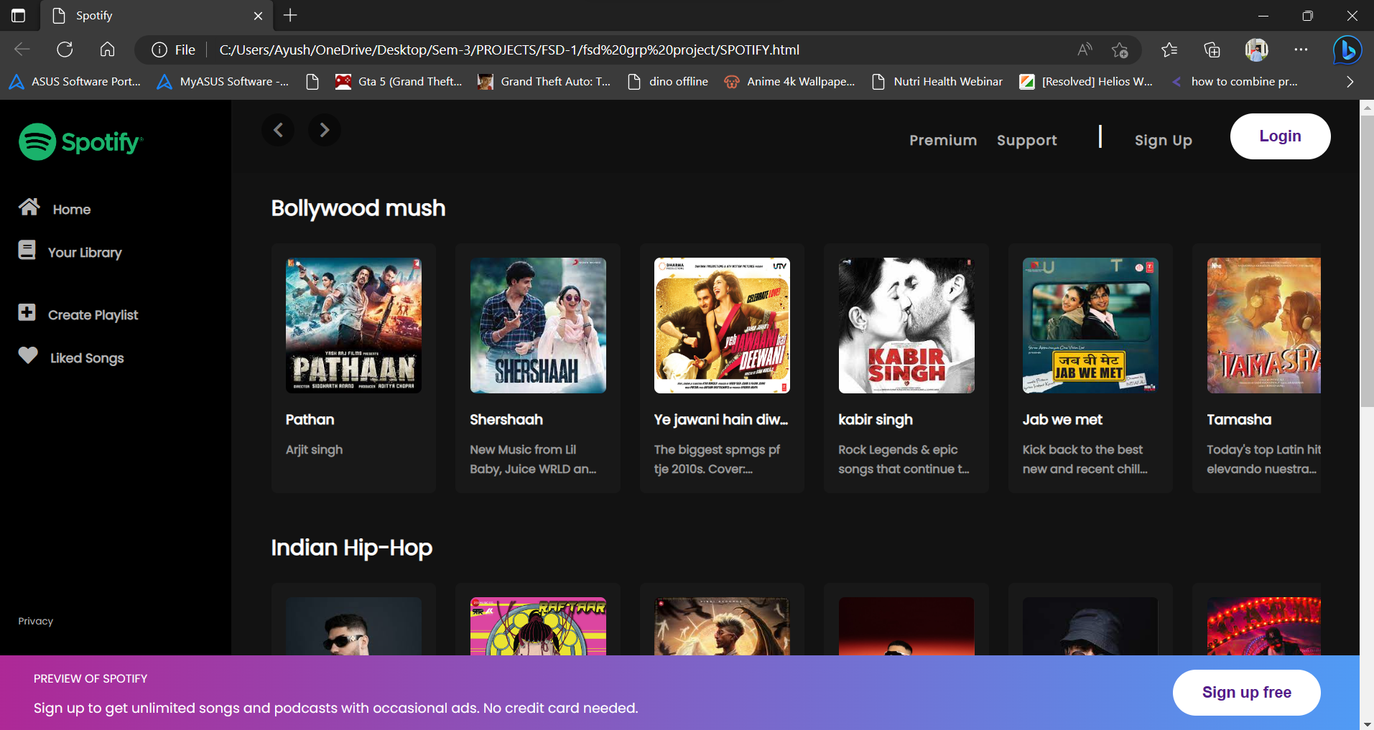

OUTPUT

Slide 7

Thank You

